Slide 1



EAS Analytics-Reporting-v2
View in Power BI
Last data refresh:
1/25/2023 1:25:51 PM UTC
Downloaded at:
1/27/2023 9:54:18 PM UTC

Slide 2
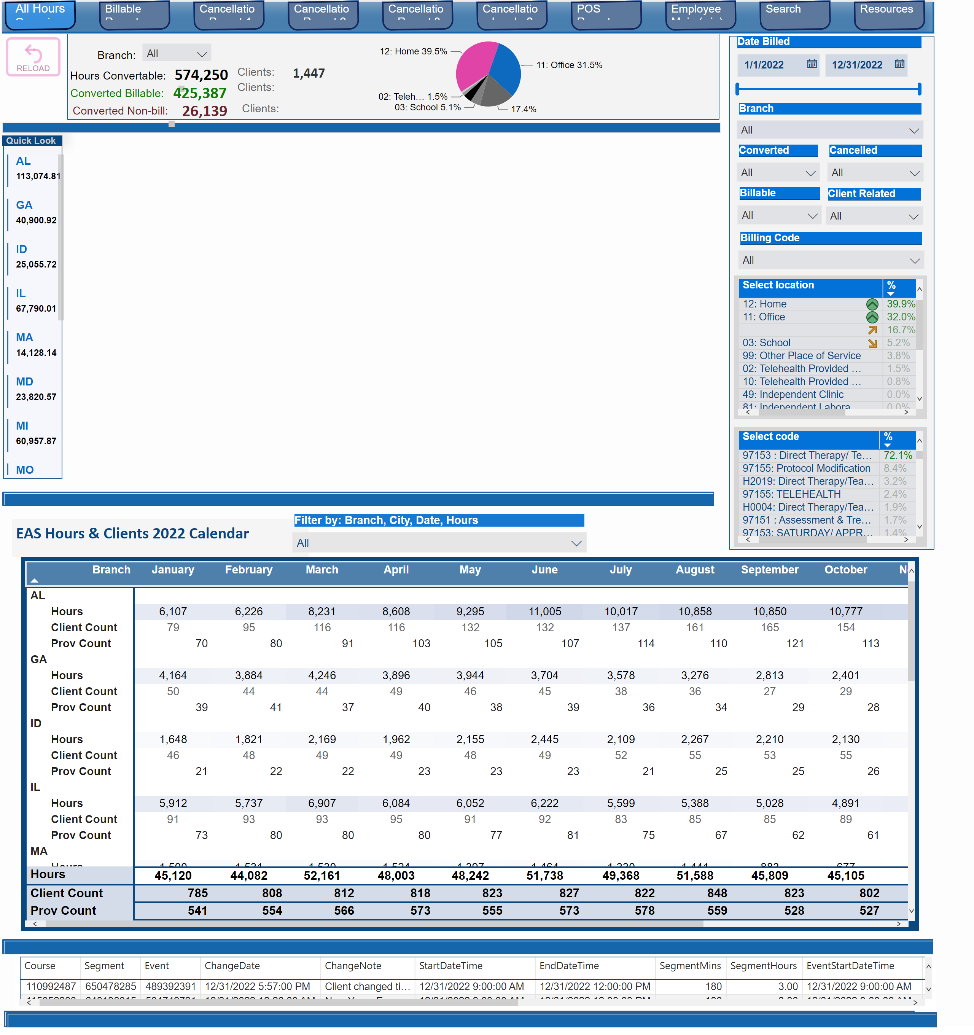
All Hours Overview
Notes:
shape
No alt text provided
tableEx
No alt text provided
shape
No alt text provided
textbox
No alt text provided
pivotTable
No alt text provided
shape
No alt text provided
Branch :
No alt text provided
pieChart
No alt text provided
slicer
No alt text provided
shape
No alt text provided
textbox
No alt text provided
Clients:
No alt text provided
card
No alt text provided
card
No alt text provided
Hours Convertable:
No alt text provided
Clients:
No alt text provided
Clients:
No alt text provided
shape
No alt text provided
Quick Look
No alt text provided
slicer
No alt text provided
slicer
No alt text provided
Branch:
No alt text provided
Converted Billable:
No alt text provided
card
No alt text provided
Converted Non-bill:
No alt text provided
card
No alt text provided
shape
No alt text provided
shape
No alt text provided
pageNavigator
No alt text provided
shape
No alt text provided
actionButton
No alt text provided
tableEx
No alt text provided
slicer
No alt text provided
slicer
No alt text provided
slicer
No alt text provided
slicer
No alt text provided
slicer
No alt text provided
slicer
No alt text provided
tableEx
No alt text provided
slicer
No alt text provided

Slide 3
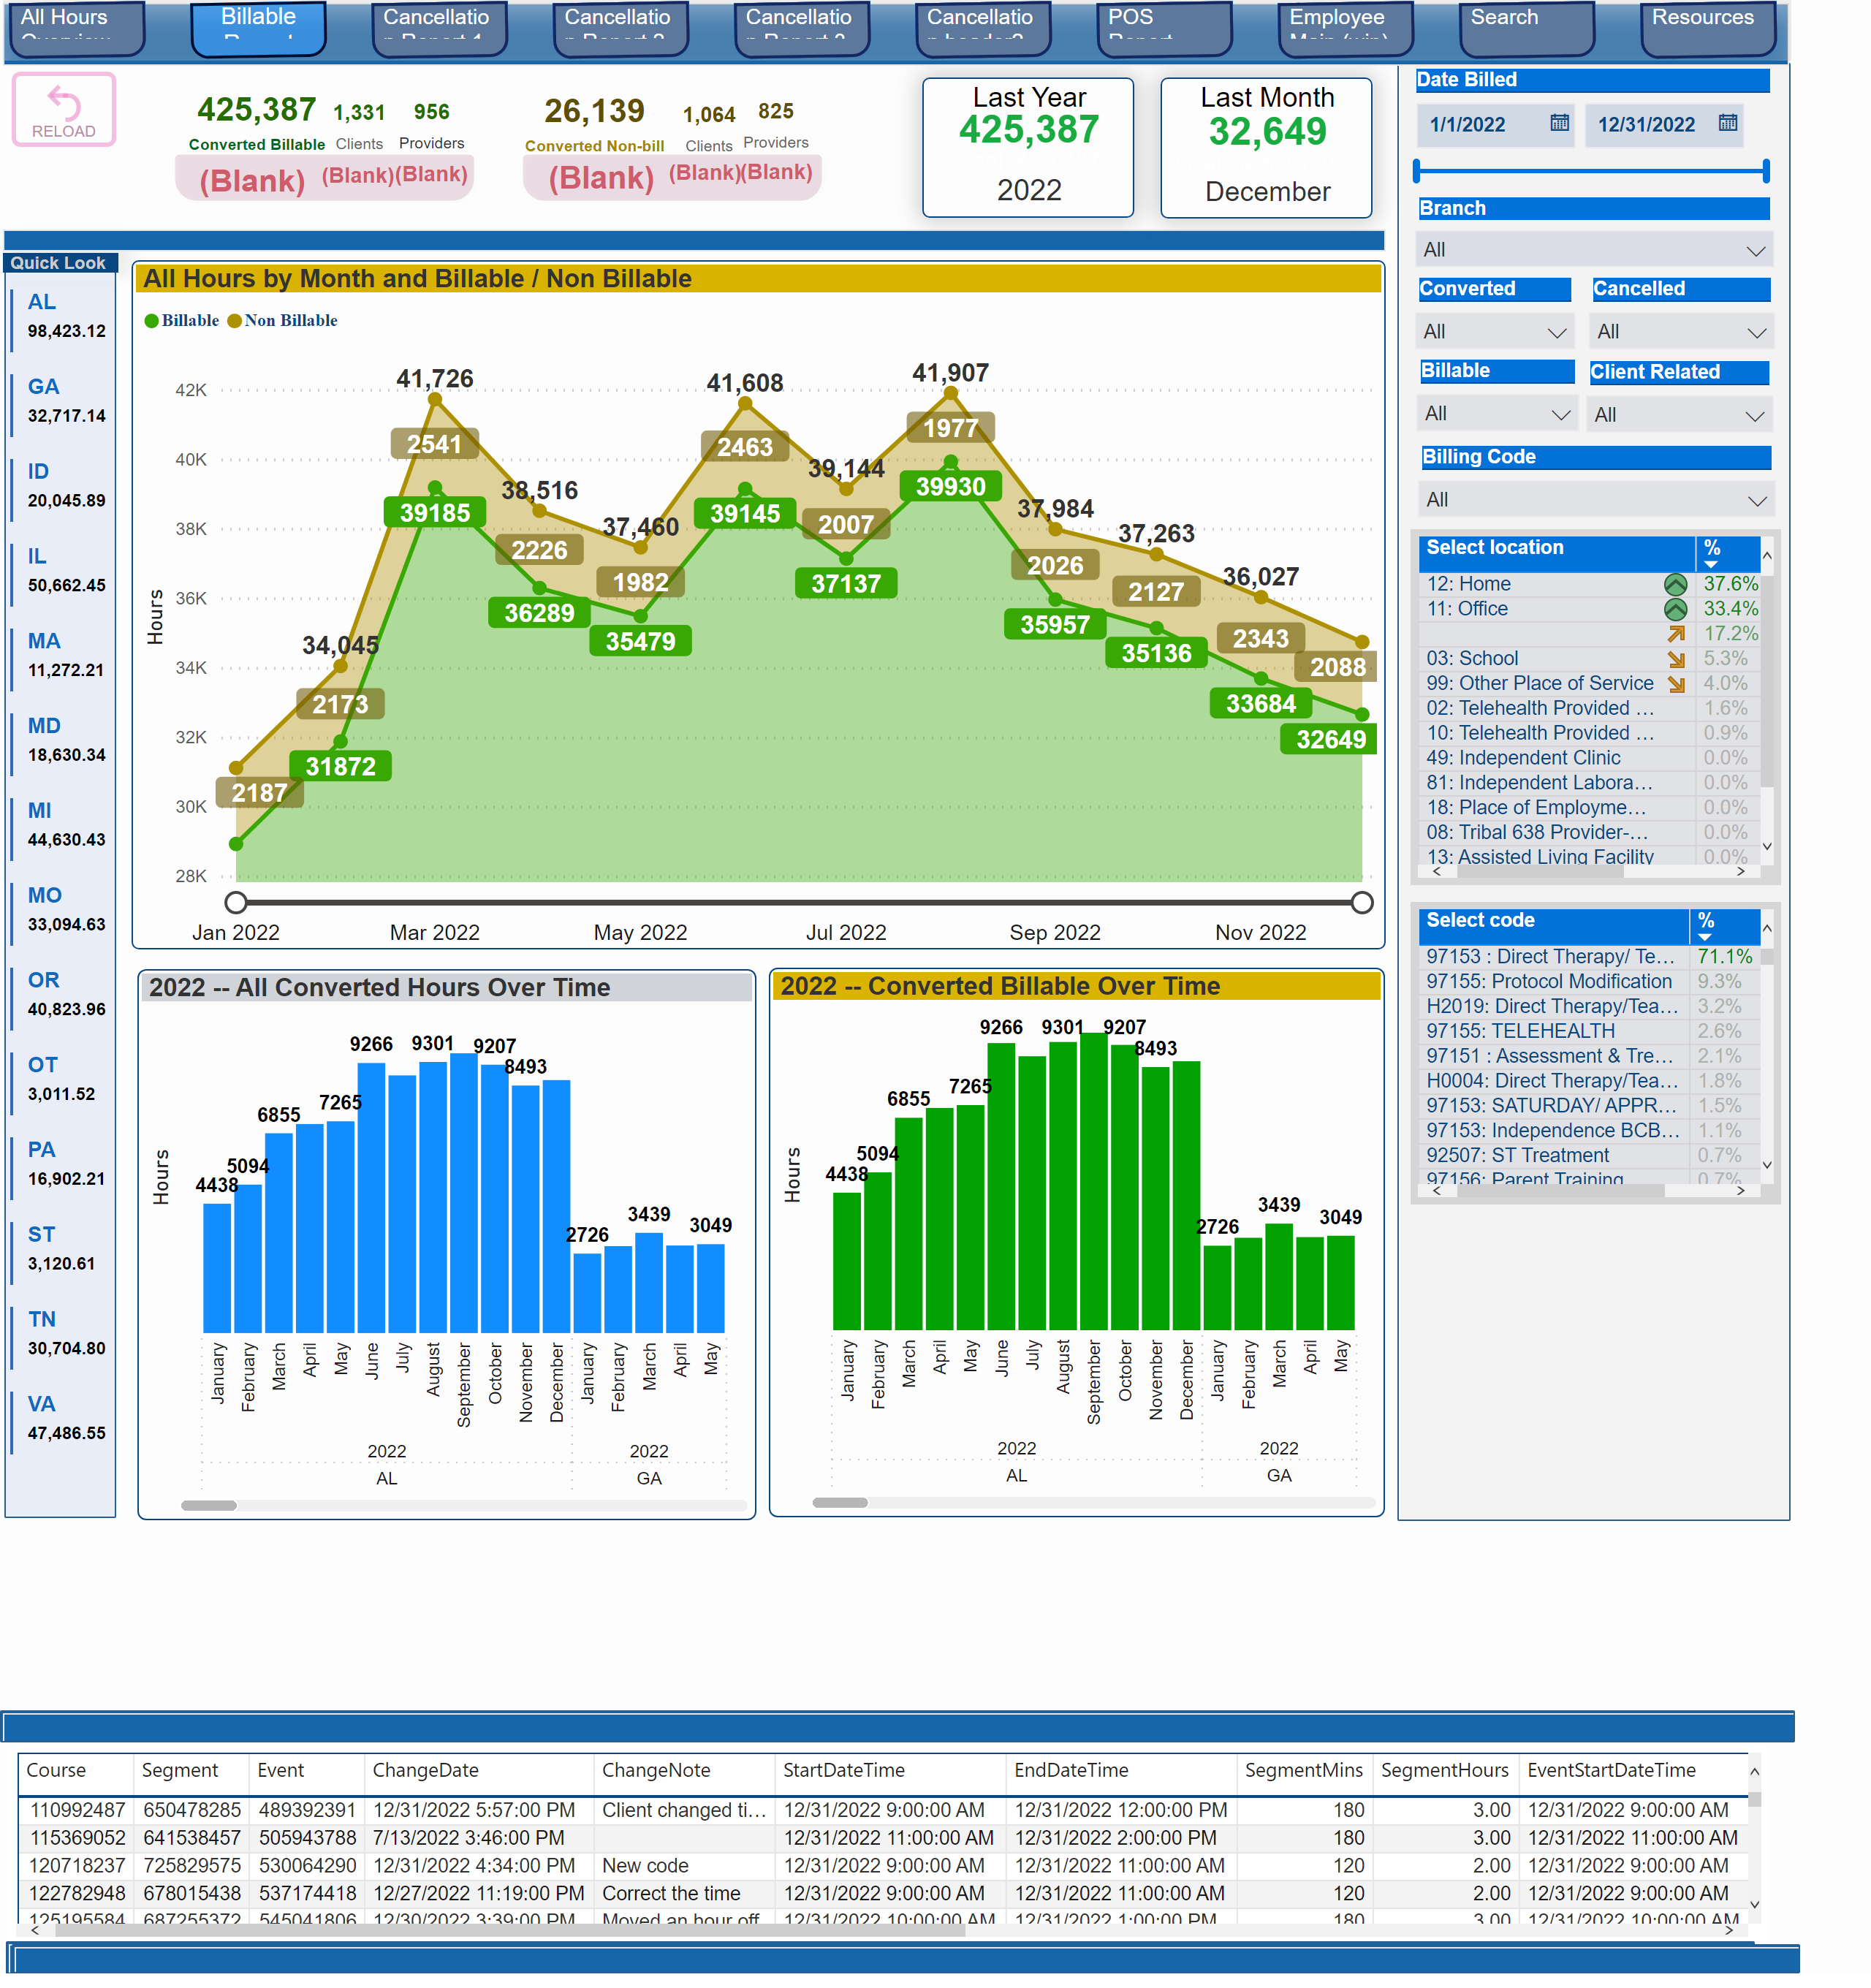
Billable Report
Notes:
Quick Look
No alt text provided
shape
No alt text provided
textbox
No alt text provided
shape
No alt text provided
tableEx
No alt text provided
shape
No alt text provided
Last Year
No alt text provided
2022 -- Converted Billable Over Time
No alt text provided
2022 -- All Converted Hours Over Time
No alt text provided
Branch :
No alt text provided
All Hours by Month and Billable / Non Billable
No alt text provided
Last Month
No alt text provided
actionButton
No alt text provided
pageNavigator
No alt text provided
shape
No alt text provided
shape
No alt text provided
shape
No alt text provided
tableEx
No alt text provided
slicer
No alt text provided
slicer
No alt text provided
slicer
No alt text provided
slicer
No alt text provided
slicer
No alt text provided
slicer
No alt text provided
tableEx
No alt text provided
slicer
No alt text provided
shape
No alt text provided
card
No alt text provided
card
No alt text provided
card
No alt text provided
card
No alt text provided
card
No alt text provided
card
No alt text provided
card
No alt text provided
card
No alt text provided
card
No alt text provided
card
No alt text provided
card
No alt text provided
card
No alt text provided
shape
No alt text provided

Slide 4
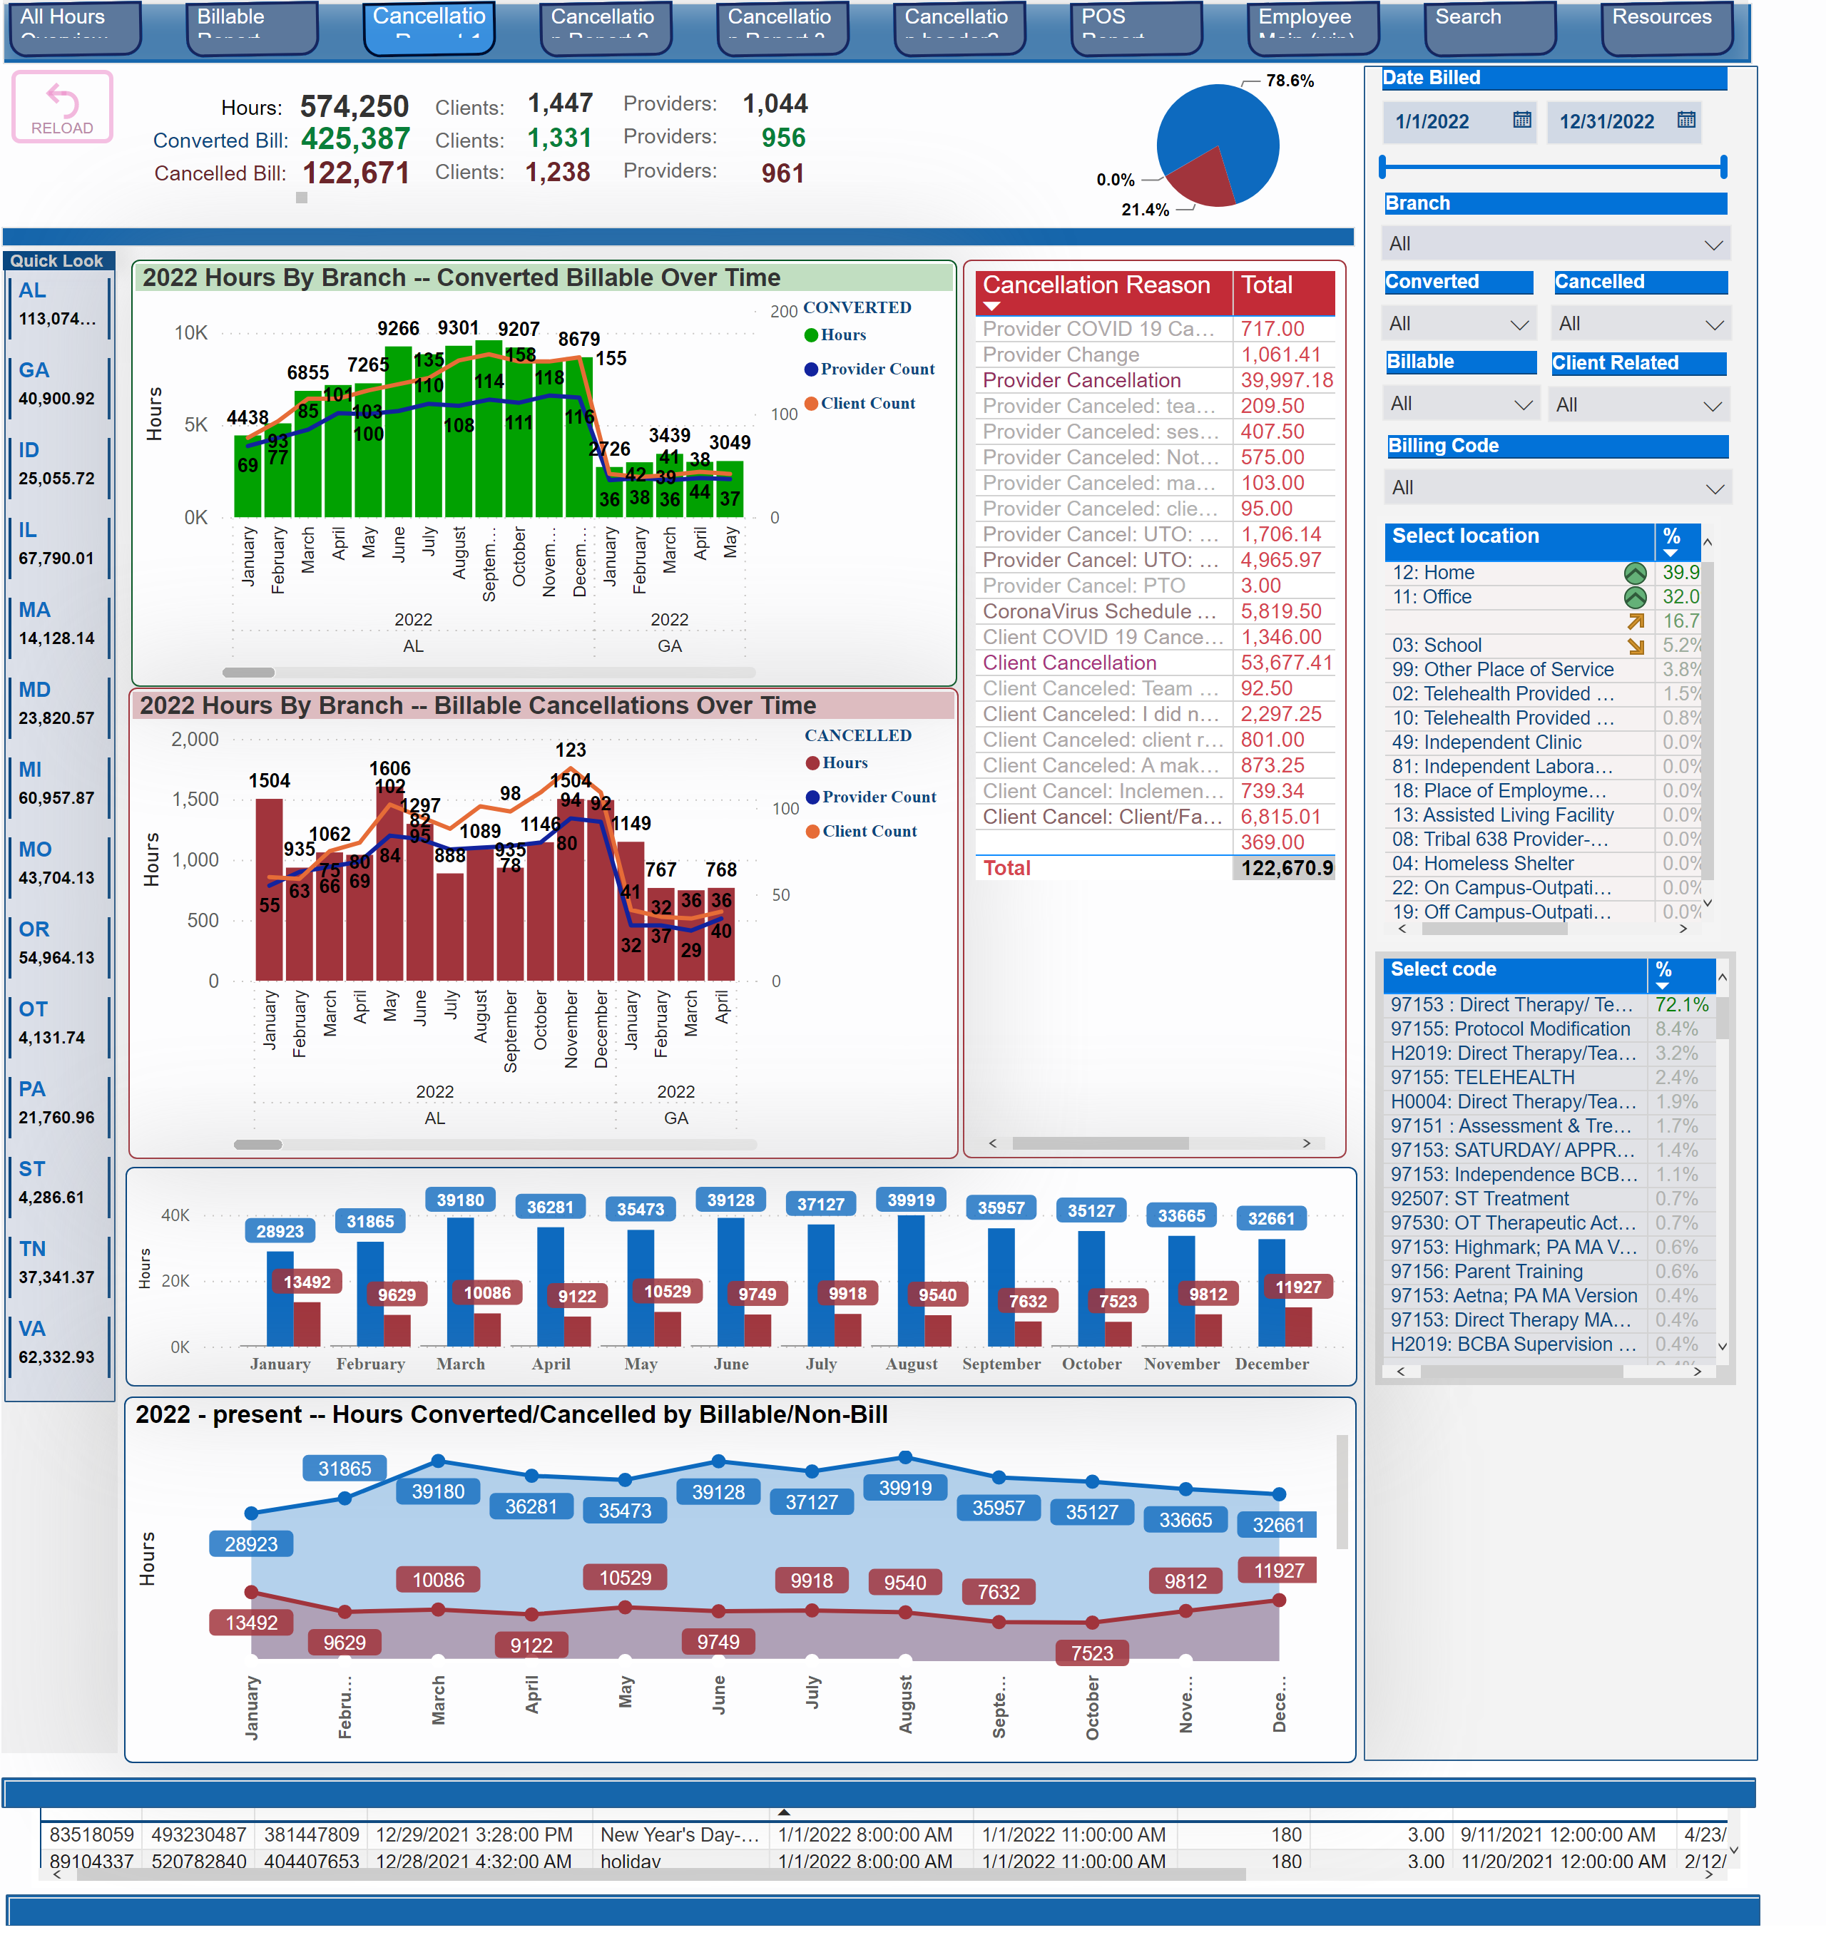
Cancellation Report 1
Notes:
Quick Look
No alt text provided
shape
No alt text provided
Clients:
No alt text provided
Clients:
No alt text provided
card
No alt text provided
card
No alt text provided
Cancelled Bill:
No alt text provided
Converted Bill:
No alt text provided
Hours:
No alt text provided
card
No alt text provided
card
No alt text provided
card
No alt text provided
card
No alt text provided
Clients:
No alt text provided
textbox
No alt text provided
pieChart
No alt text provided
shape
No alt text provided
tableEx
No alt text provided
shape
No alt text provided
Providers:
No alt text provided
card
No alt text provided
Providers:
No alt text provided
card
No alt text provided
card
No alt text provided
Providers:
No alt text provided
Branch :
No alt text provided
2022 Hours By Branch -- Billable Cancellations Over Time
No alt text provided
2022 Hours By Branch -- Converted Billable Over Time
No alt text provided
tableEx
No alt text provided
2022 All Hours Converted/Cancelled
No alt text provided
2022 - present -- Hours Converted/Cancelled by Billable/Non-Bill
No alt text provided
actionButton
No alt text provided
pageNavigator
No alt text provided
shape
No alt text provided
shape
No alt text provided
slicer
No alt text provided
tableEx
No alt text provided
slicer
No alt text provided
slicer
No alt text provided
slicer
No alt text provided
slicer
No alt text provided
slicer
No alt text provided
slicer
No alt text provided
tableEx
No alt text provided

Slide 5
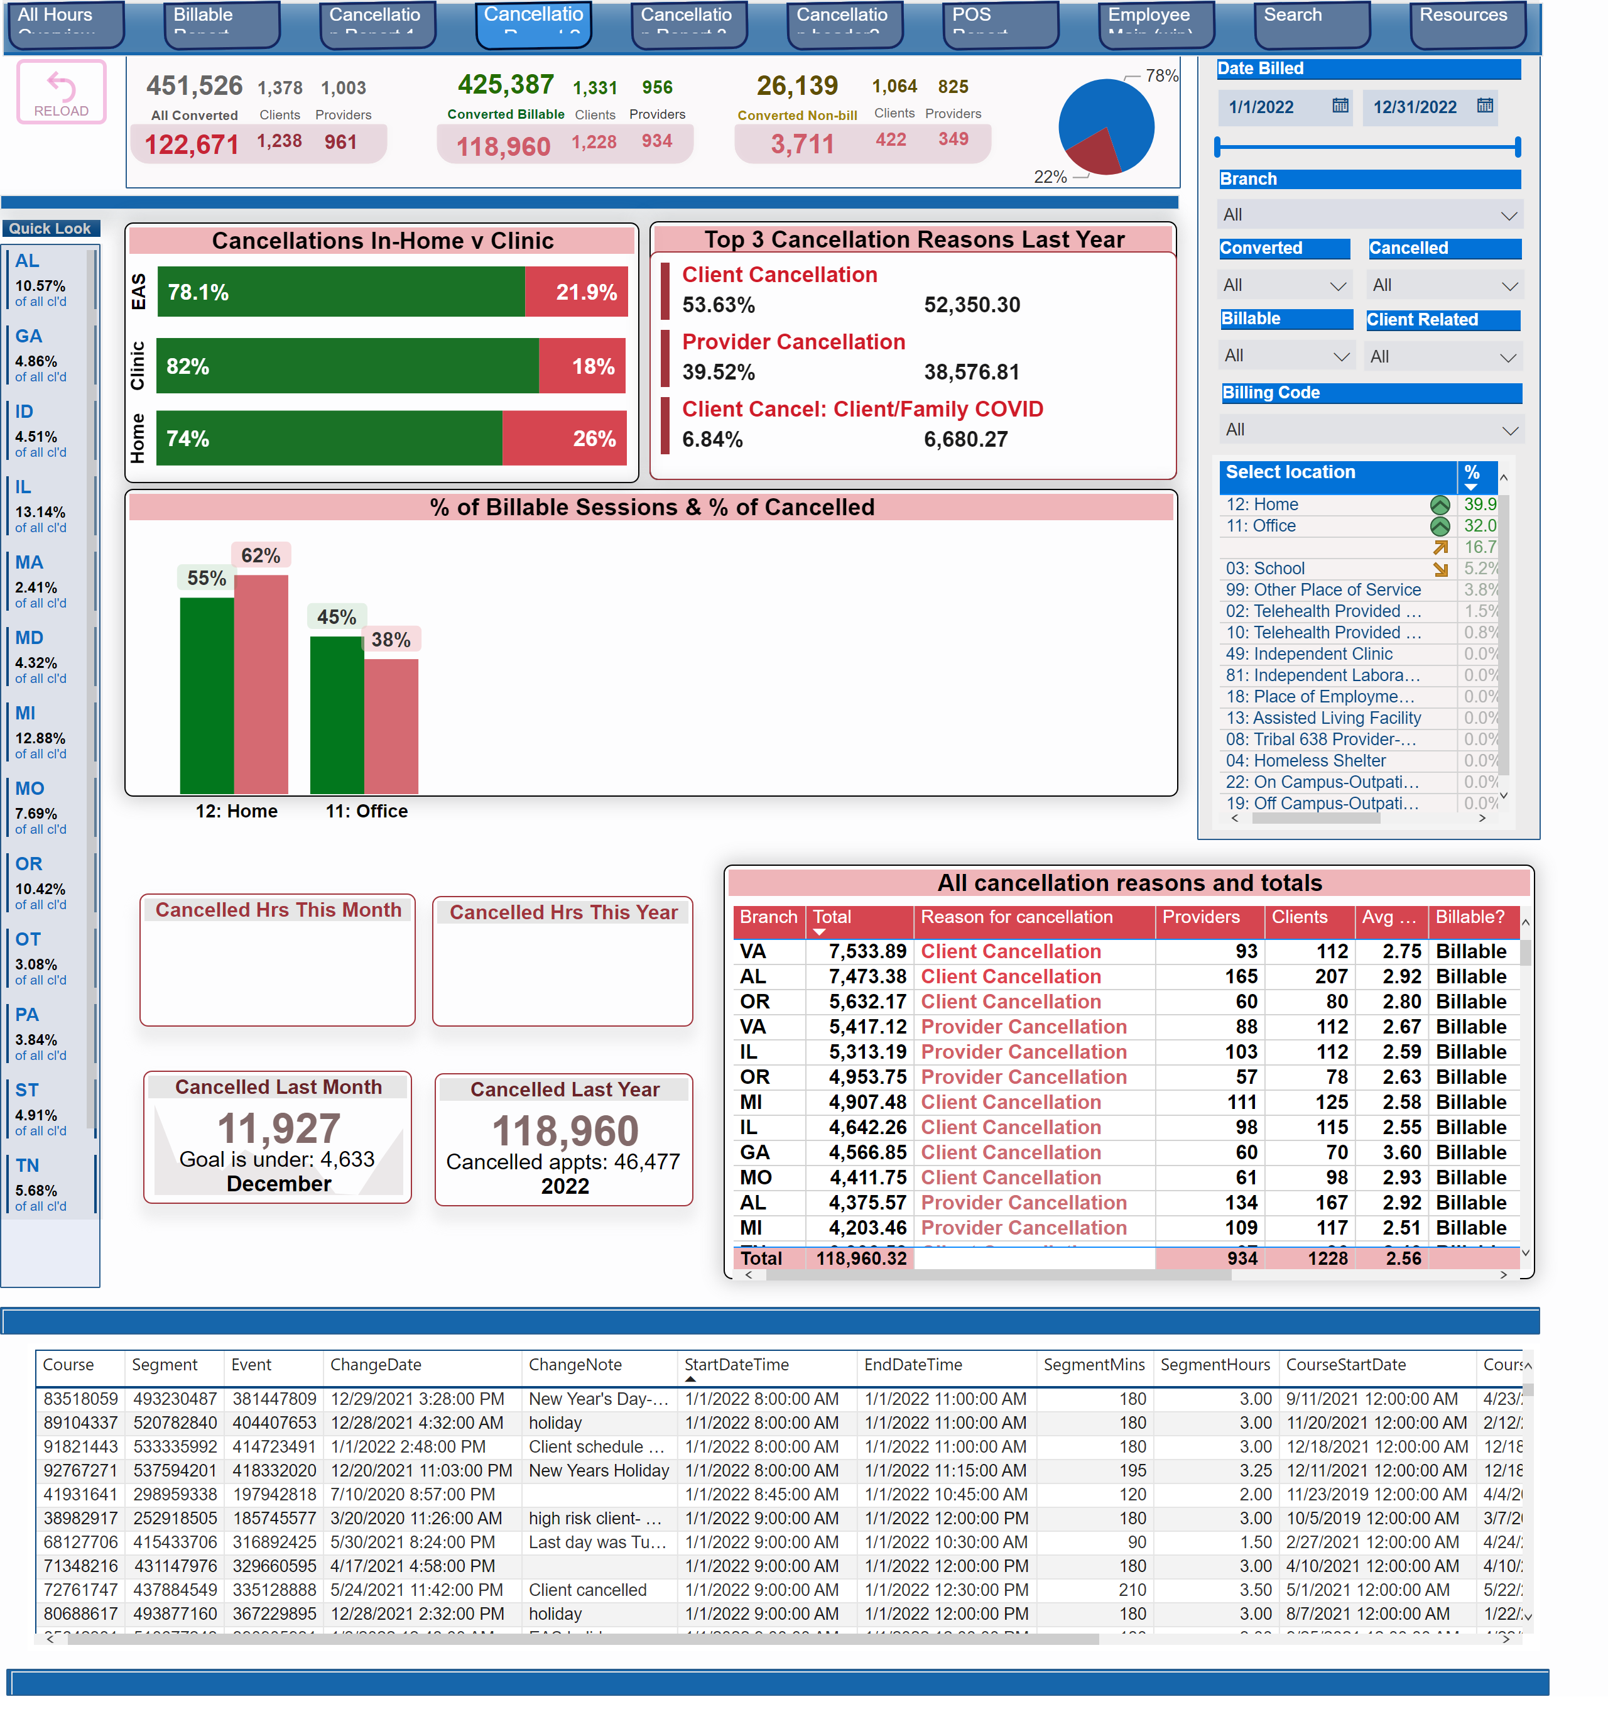
Cancellation Report 2
Notes:
shape
No alt text provided
card
No alt text provided
card
No alt text provided
card
No alt text provided
card
No alt text provided
card
No alt text provided
card
No alt text provided
card
No alt text provided
card
No alt text provided
card
No alt text provided
slicer
No alt text provided
Top 3 Cancellation Reasons Last Year
No alt text provided
multiRowCard
No alt text provided
card
No alt text provided
card
No alt text provided
card
No alt text provided
card
No alt text provided
card
No alt text provided
card
No alt text provided
2022 All Hours Converted/Cancelled
No alt text provided
slicer
No alt text provided
Quick Look
No alt text provided
slicer
No alt text provided
slicer
No alt text provided
shape
No alt text provided
card
No alt text provided
card
No alt text provided
card
No alt text provided
textbox
No alt text provided
shape
No alt text provided
pieChart
No alt text provided
shape
No alt text provided
shape
No alt text provided
tableEx
No alt text provided
shape
No alt text provided
pageNavigator
No alt text provided
slicer
No alt text provided
actionButton
No alt text provided
Branch :
No alt text provided
shape
No alt text provided
shape
No alt text provided
Cancelled Last Month
No alt text provided
2022 All Hours Converted/Cancelled
No alt text provided
2022 All Hours Converted/Cancelled
No alt text provided
% of Billable Hours & % of Cancelled Sessions
No alt text provided
% of Billable Sessions & % of Cancelled
No alt text provided
All cancellation reasons and totals
No alt text provided
Cancellations In-Home v Clinic
No alt text provided
shape
No alt text provided
slicer
No alt text provided
tableEx
No alt text provided
slicer
No alt text provided
shape
No alt text provided
Cancelled Hrs This Year
No alt text provided
tableEx
No alt text provided
Cancelled Hrs This Month
No alt text provided
Cancelled Last Year
No alt text provided

Slide 6
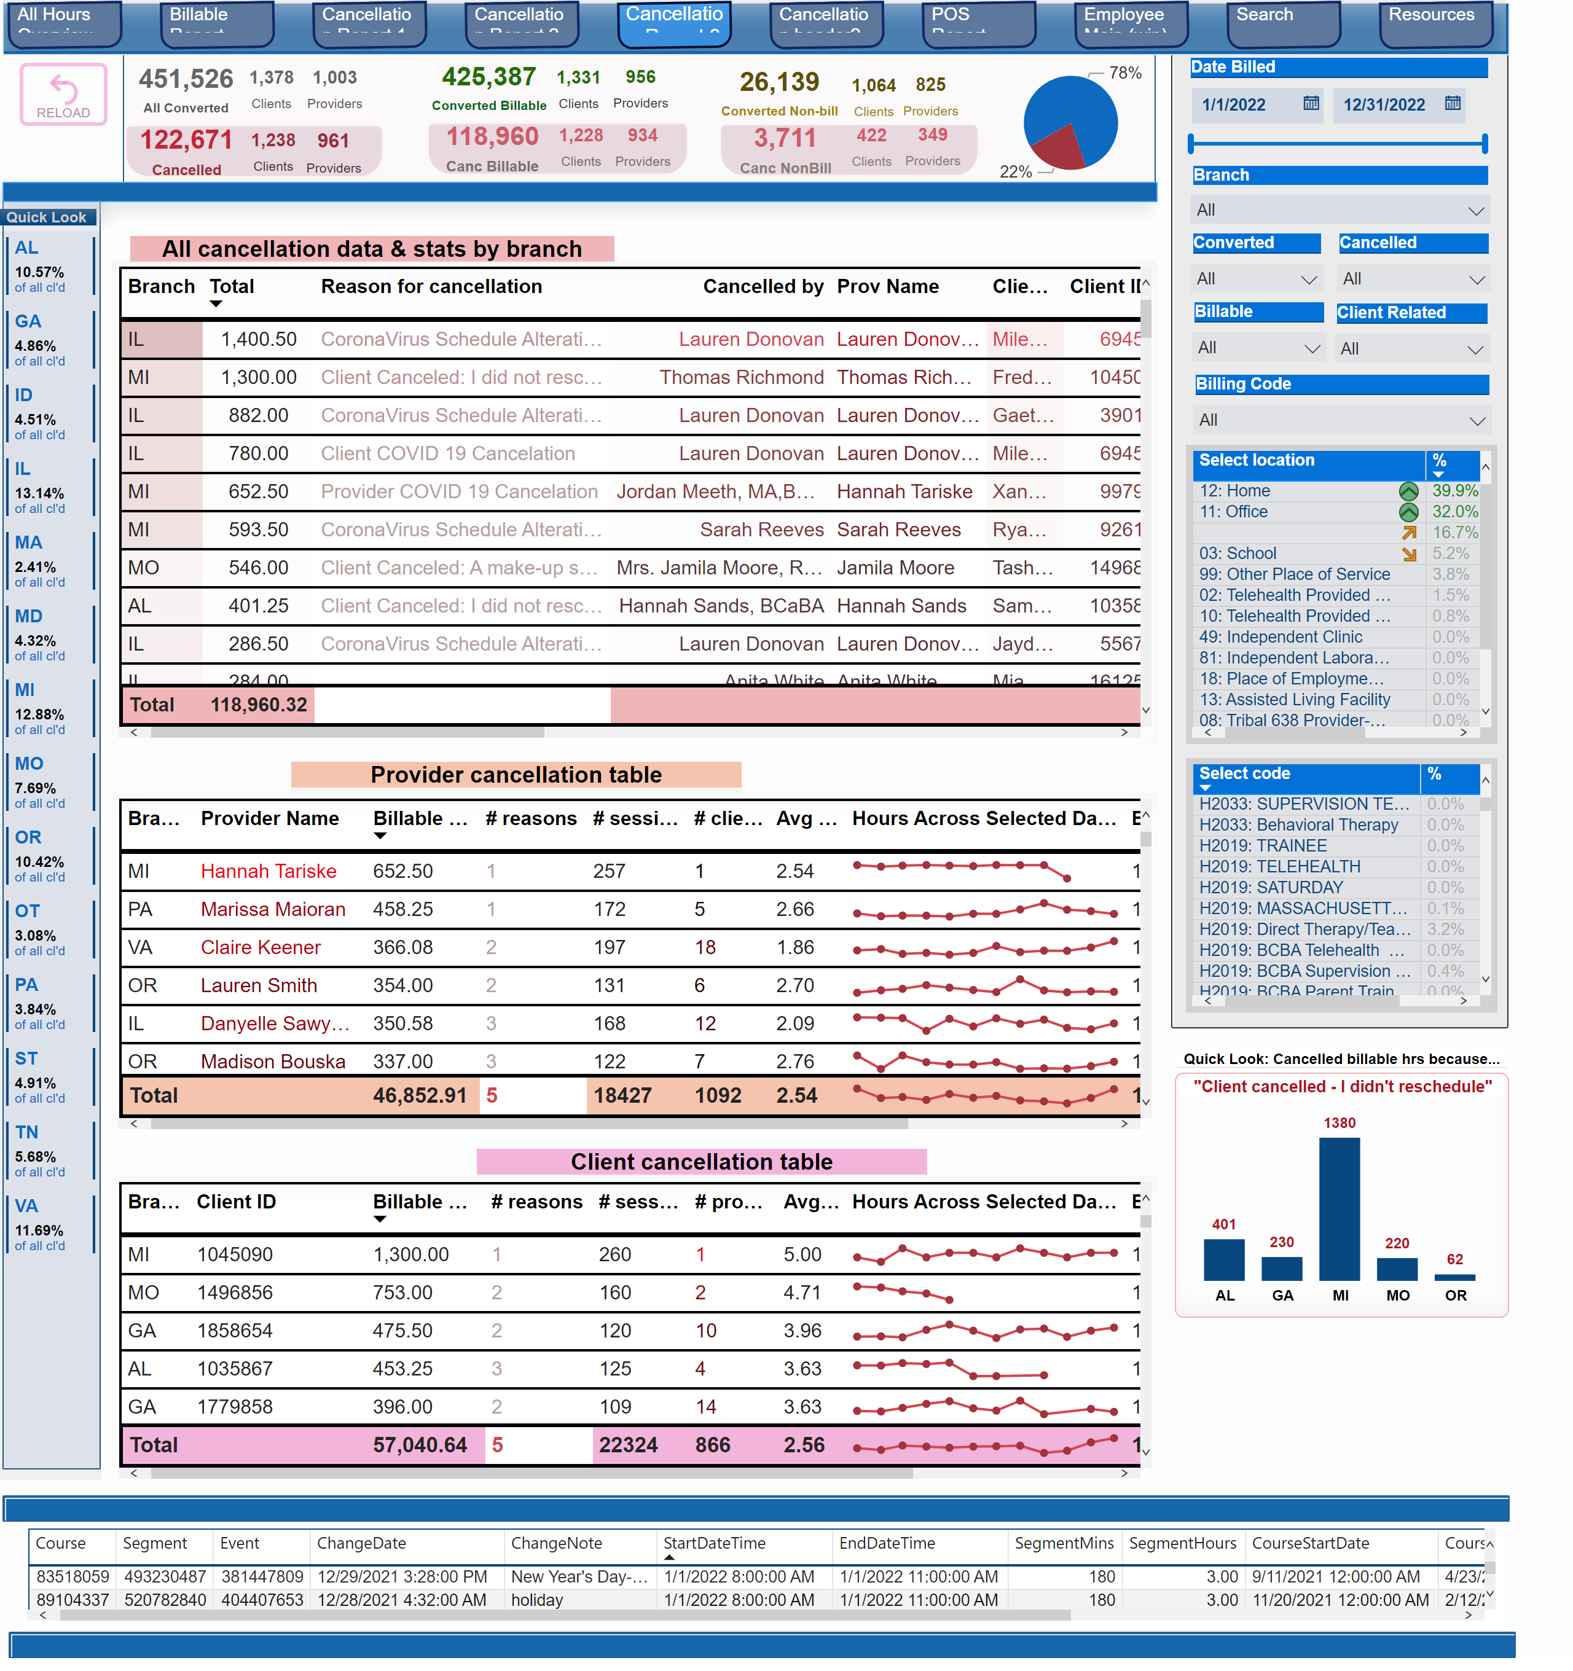
Cancellation Report 3
Notes:
pageNavigator
No alt text provided
shape
No alt text provided
tableEx
No alt text provided
All cancellation data & stats by branch
No alt text provided
tableEx
No alt text provided
Client cancellation table
No alt text provided
tableEx
No alt text provided
shape
No alt text provided
shape
No alt text provided
slicer
No alt text provided
tableEx
No alt text provided
slicer
No alt text provided
Provider cancellation table
No alt text provided
shape
No alt text provided
shape
No alt text provided
Branch :
No alt text provided
actionButton
No alt text provided
slicer
No alt text provided
tableEx
No alt text provided
shape
No alt text provided
pieChart
No alt text provided
shape
No alt text provided
textbox
No alt text provided
card
No alt text provided
card
No alt text provided
card
No alt text provided
shape
No alt text provided
slicer
No alt text provided
slicer
No alt text provided
Quick Look
No alt text provided
slicer
No alt text provided
card
No alt text provided
card
No alt text provided
card
No alt text provided
card
No alt text provided
card
No alt text provided
card
No alt text provided
slicer
No alt text provided
card
No alt text provided
card
No alt text provided
card
No alt text provided
card
No alt text provided
card
No alt text provided
card
No alt text provided
card
No alt text provided
card
No alt text provided
card
No alt text provided
shape
No alt text provided
Quick Look: Cancelled billable hrs because...
No alt text provided
% of Billable Hours & % of Cancelled Sessions
No alt text provided
"Client cancelled - I didn't reschedule"
No alt text provided
tableEx
No alt text provided

Slide 7
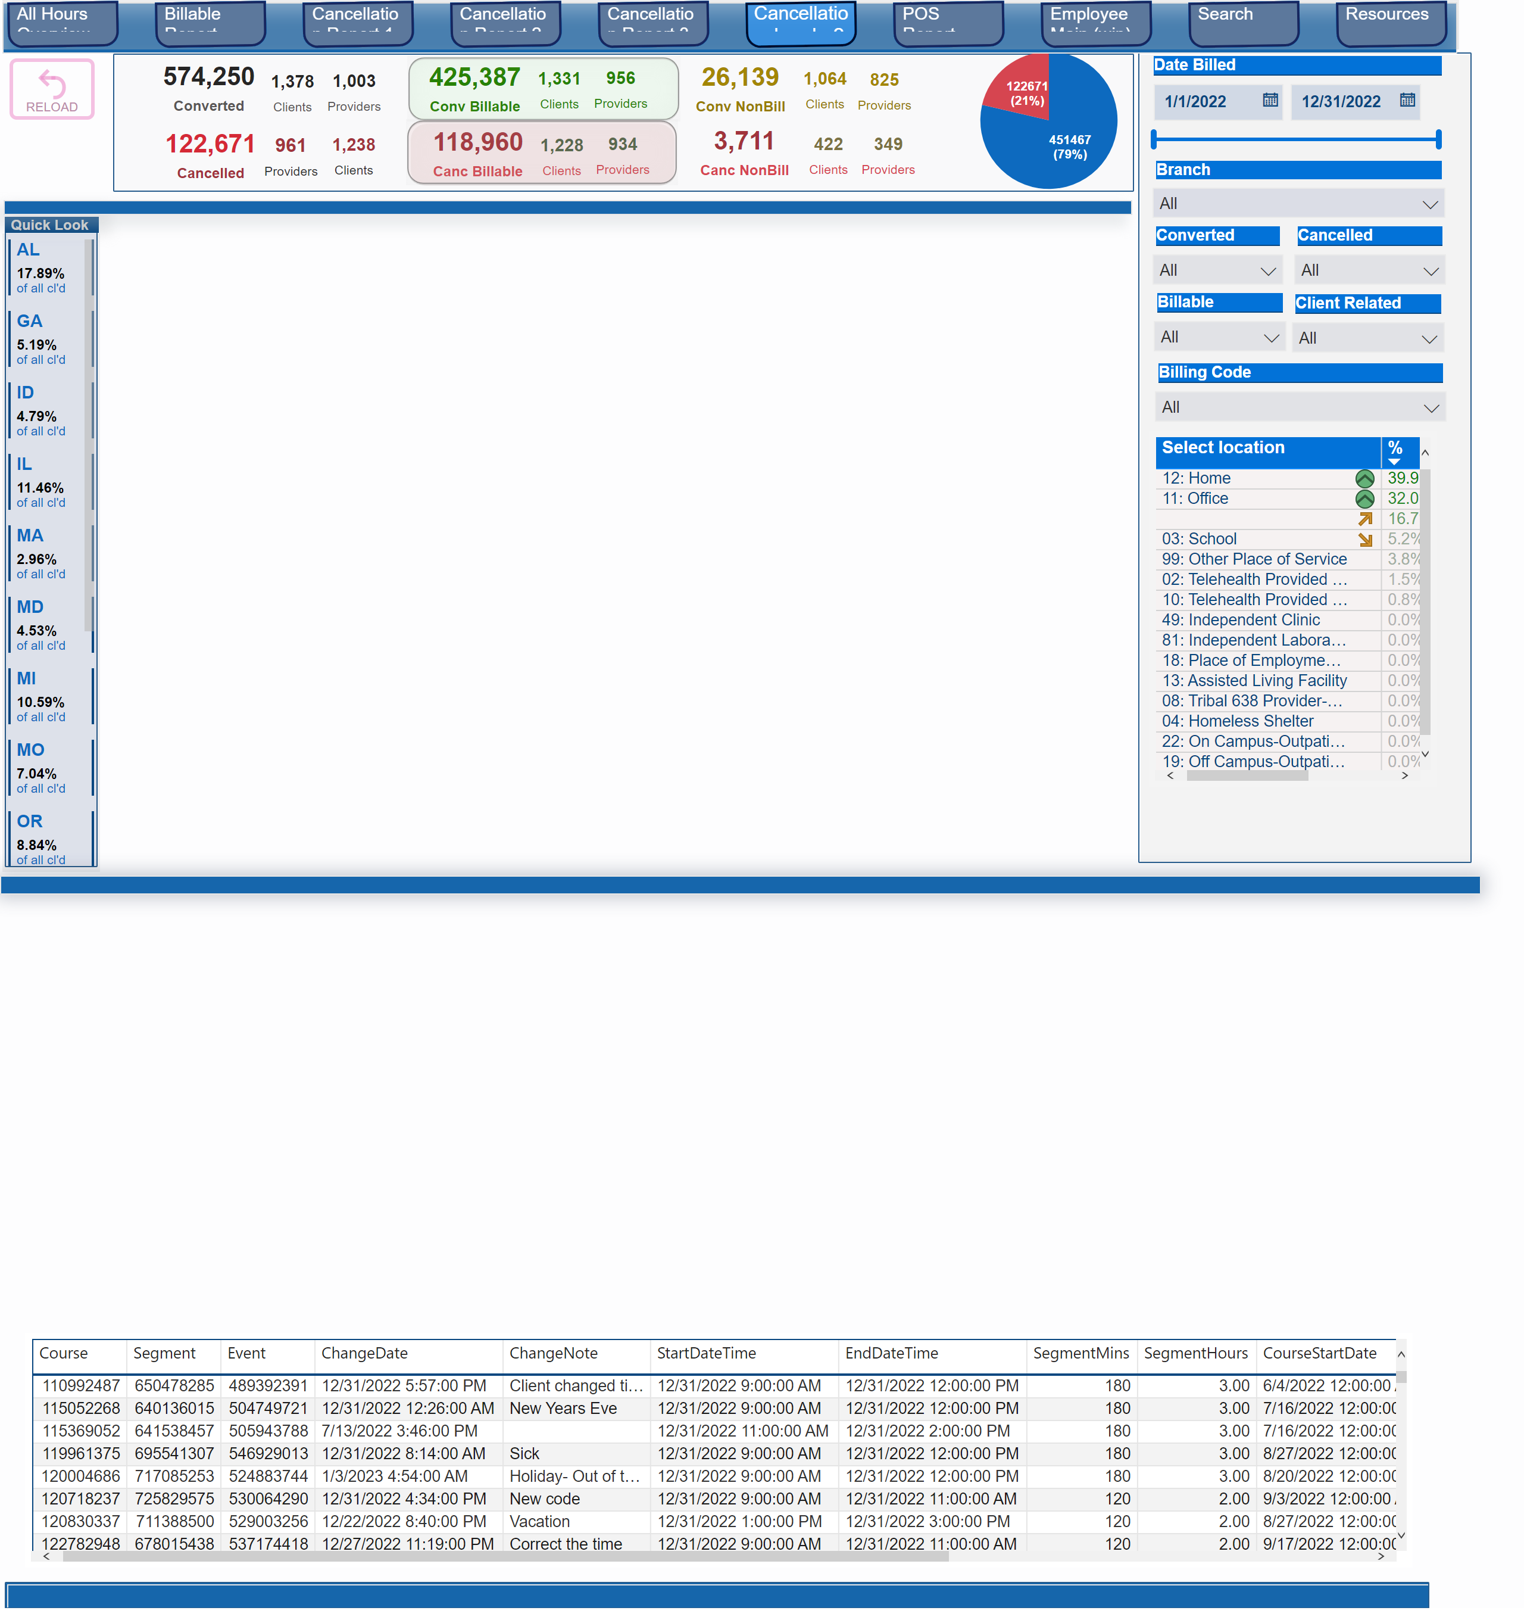
Cancellation header?
Notes:
Branch :
No alt text provided
shape
No alt text provided
tableEx
No alt text provided
shape
No alt text provided
shape
No alt text provided
pieChart
No alt text provided
shape
No alt text provided
textbox
No alt text provided
card
No alt text provided
card
No alt text provided
card
No alt text provided
shape
No alt text provided
Quick Look
No alt text provided
card
No alt text provided
card
No alt text provided
card
No alt text provided
card
No alt text provided
card
No alt text provided
card
No alt text provided
card
No alt text provided
card
No alt text provided
card
No alt text provided
card
No alt text provided
card
No alt text provided
card
No alt text provided
shape
No alt text provided
card
No alt text provided
card
No alt text provided
card
No alt text provided
shape
No alt text provided
shape
No alt text provided
actionButton
No alt text provided
pageNavigator
No alt text provided
shape
No alt text provided
slicer
No alt text provided
tableEx
No alt text provided
slicer
No alt text provided
slicer
No alt text provided
slicer
No alt text provided
slicer
No alt text provided
slicer
No alt text provided
slicer
No alt text provided

Slide 8
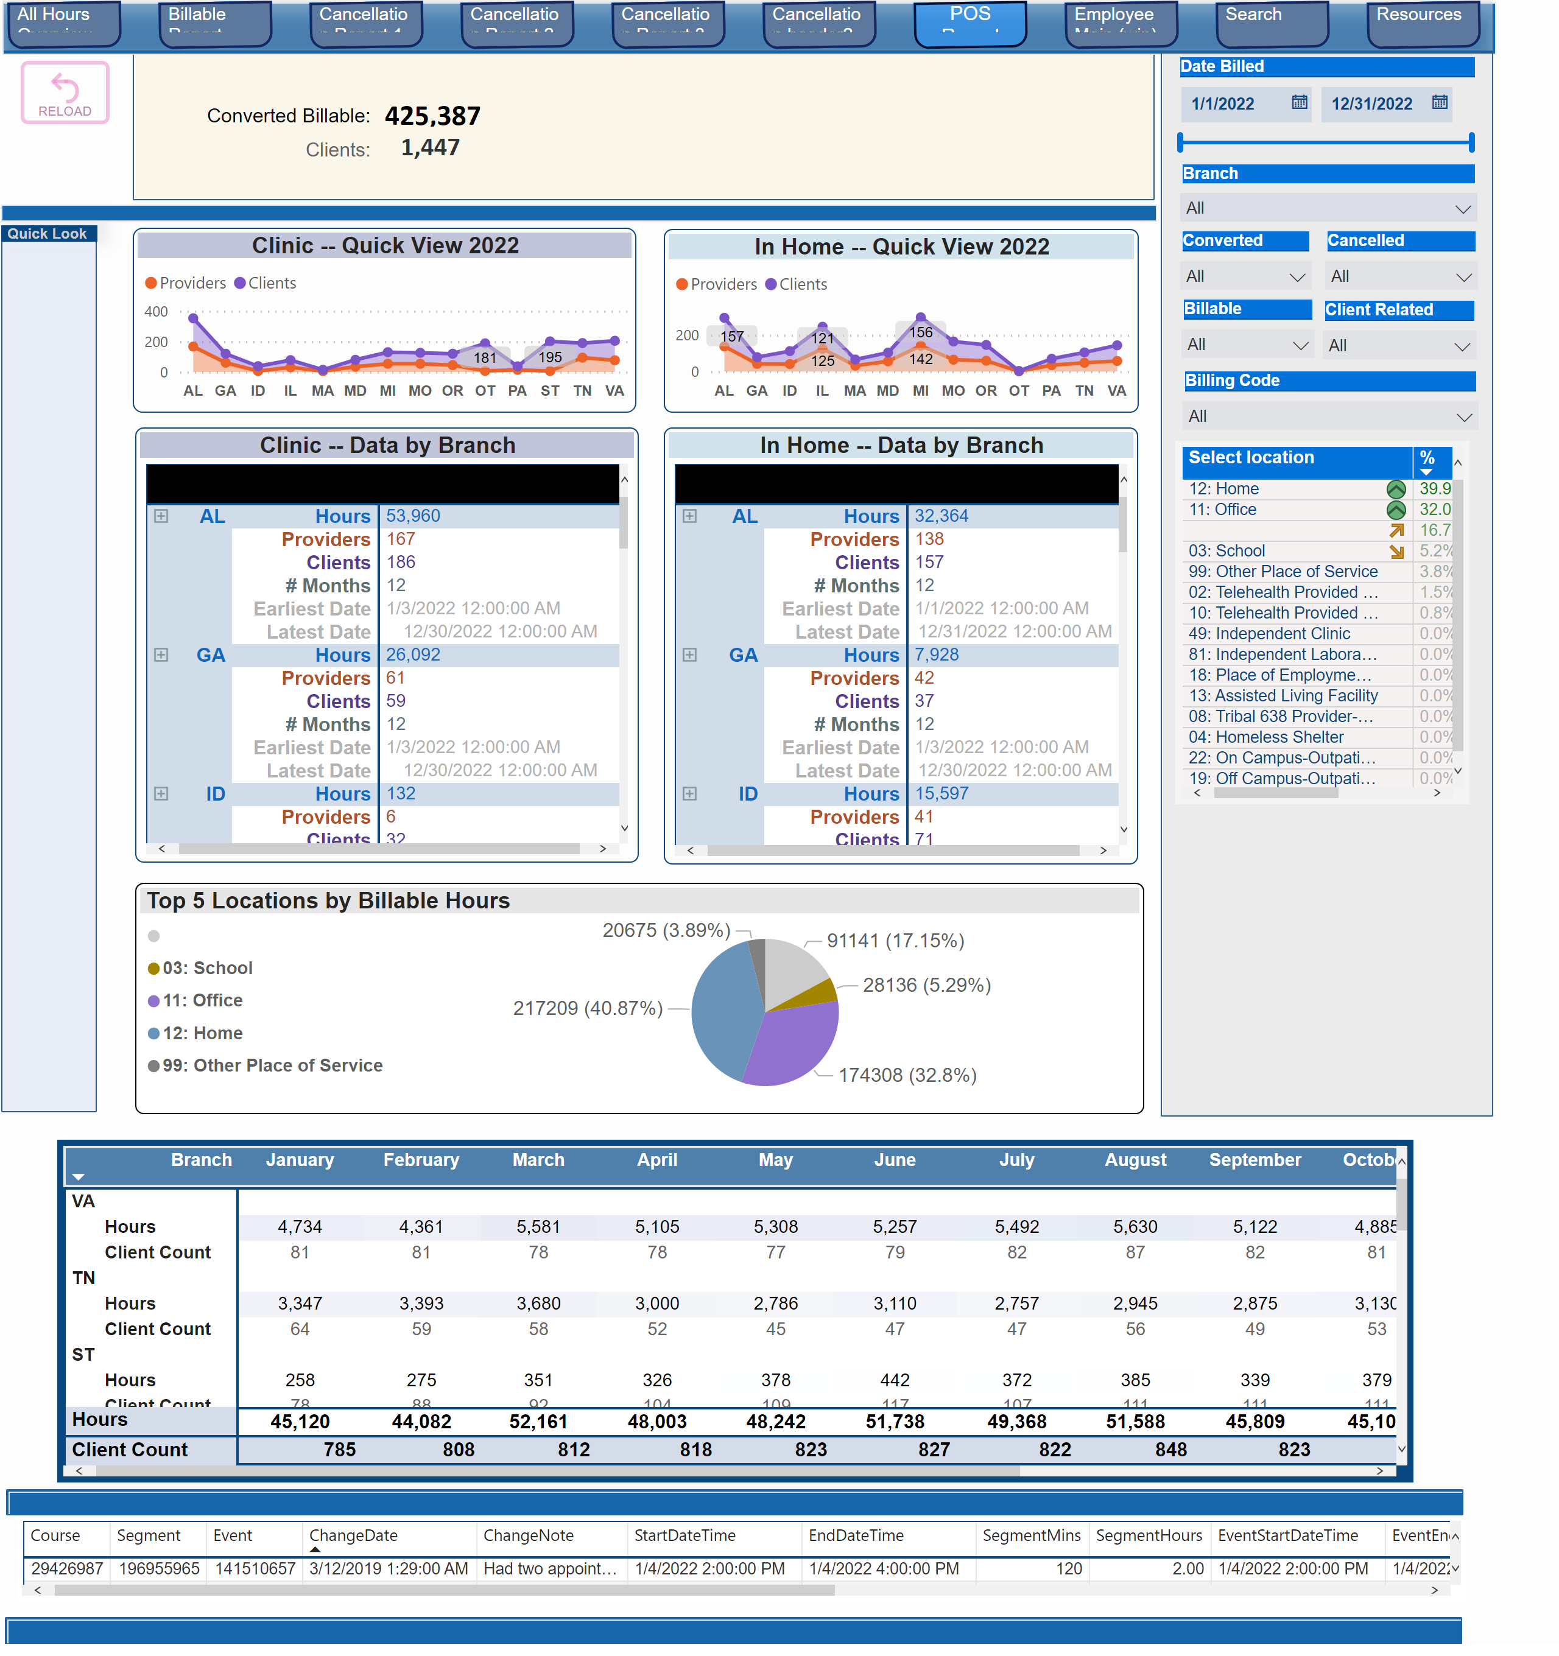
POS Report
Notes:
Top 5 Locations by Billable Hours
No alt text provided
shape
No alt text provided
tableEx
No alt text provided
shape
No alt text provided
pivotTable
No alt text provided
shape
No alt text provided
textbox
No alt text provided
Clients:
No alt text provided
card
No alt text provided
card
No alt text provided
Converted Billable:
No alt text provided
Quick Look
No alt text provided
In Home -- Quick View 2022
No alt text provided
Clinic -- Data by Branch
No alt text provided
In Home -- Data by Branch
No alt text provided
Clinic -- Quick View 2022
No alt text provided
shape
No alt text provided
actionButton
No alt text provided
shape
No alt text provided
pageNavigator
No alt text provided
slicer
No alt text provided
tableEx
No alt text provided
slicer
No alt text provided
slicer
No alt text provided
shape
No alt text provided
slicer
No alt text provided
slicer
No alt text provided
slicer
No alt text provided
slicer
No alt text provided

Slide 9
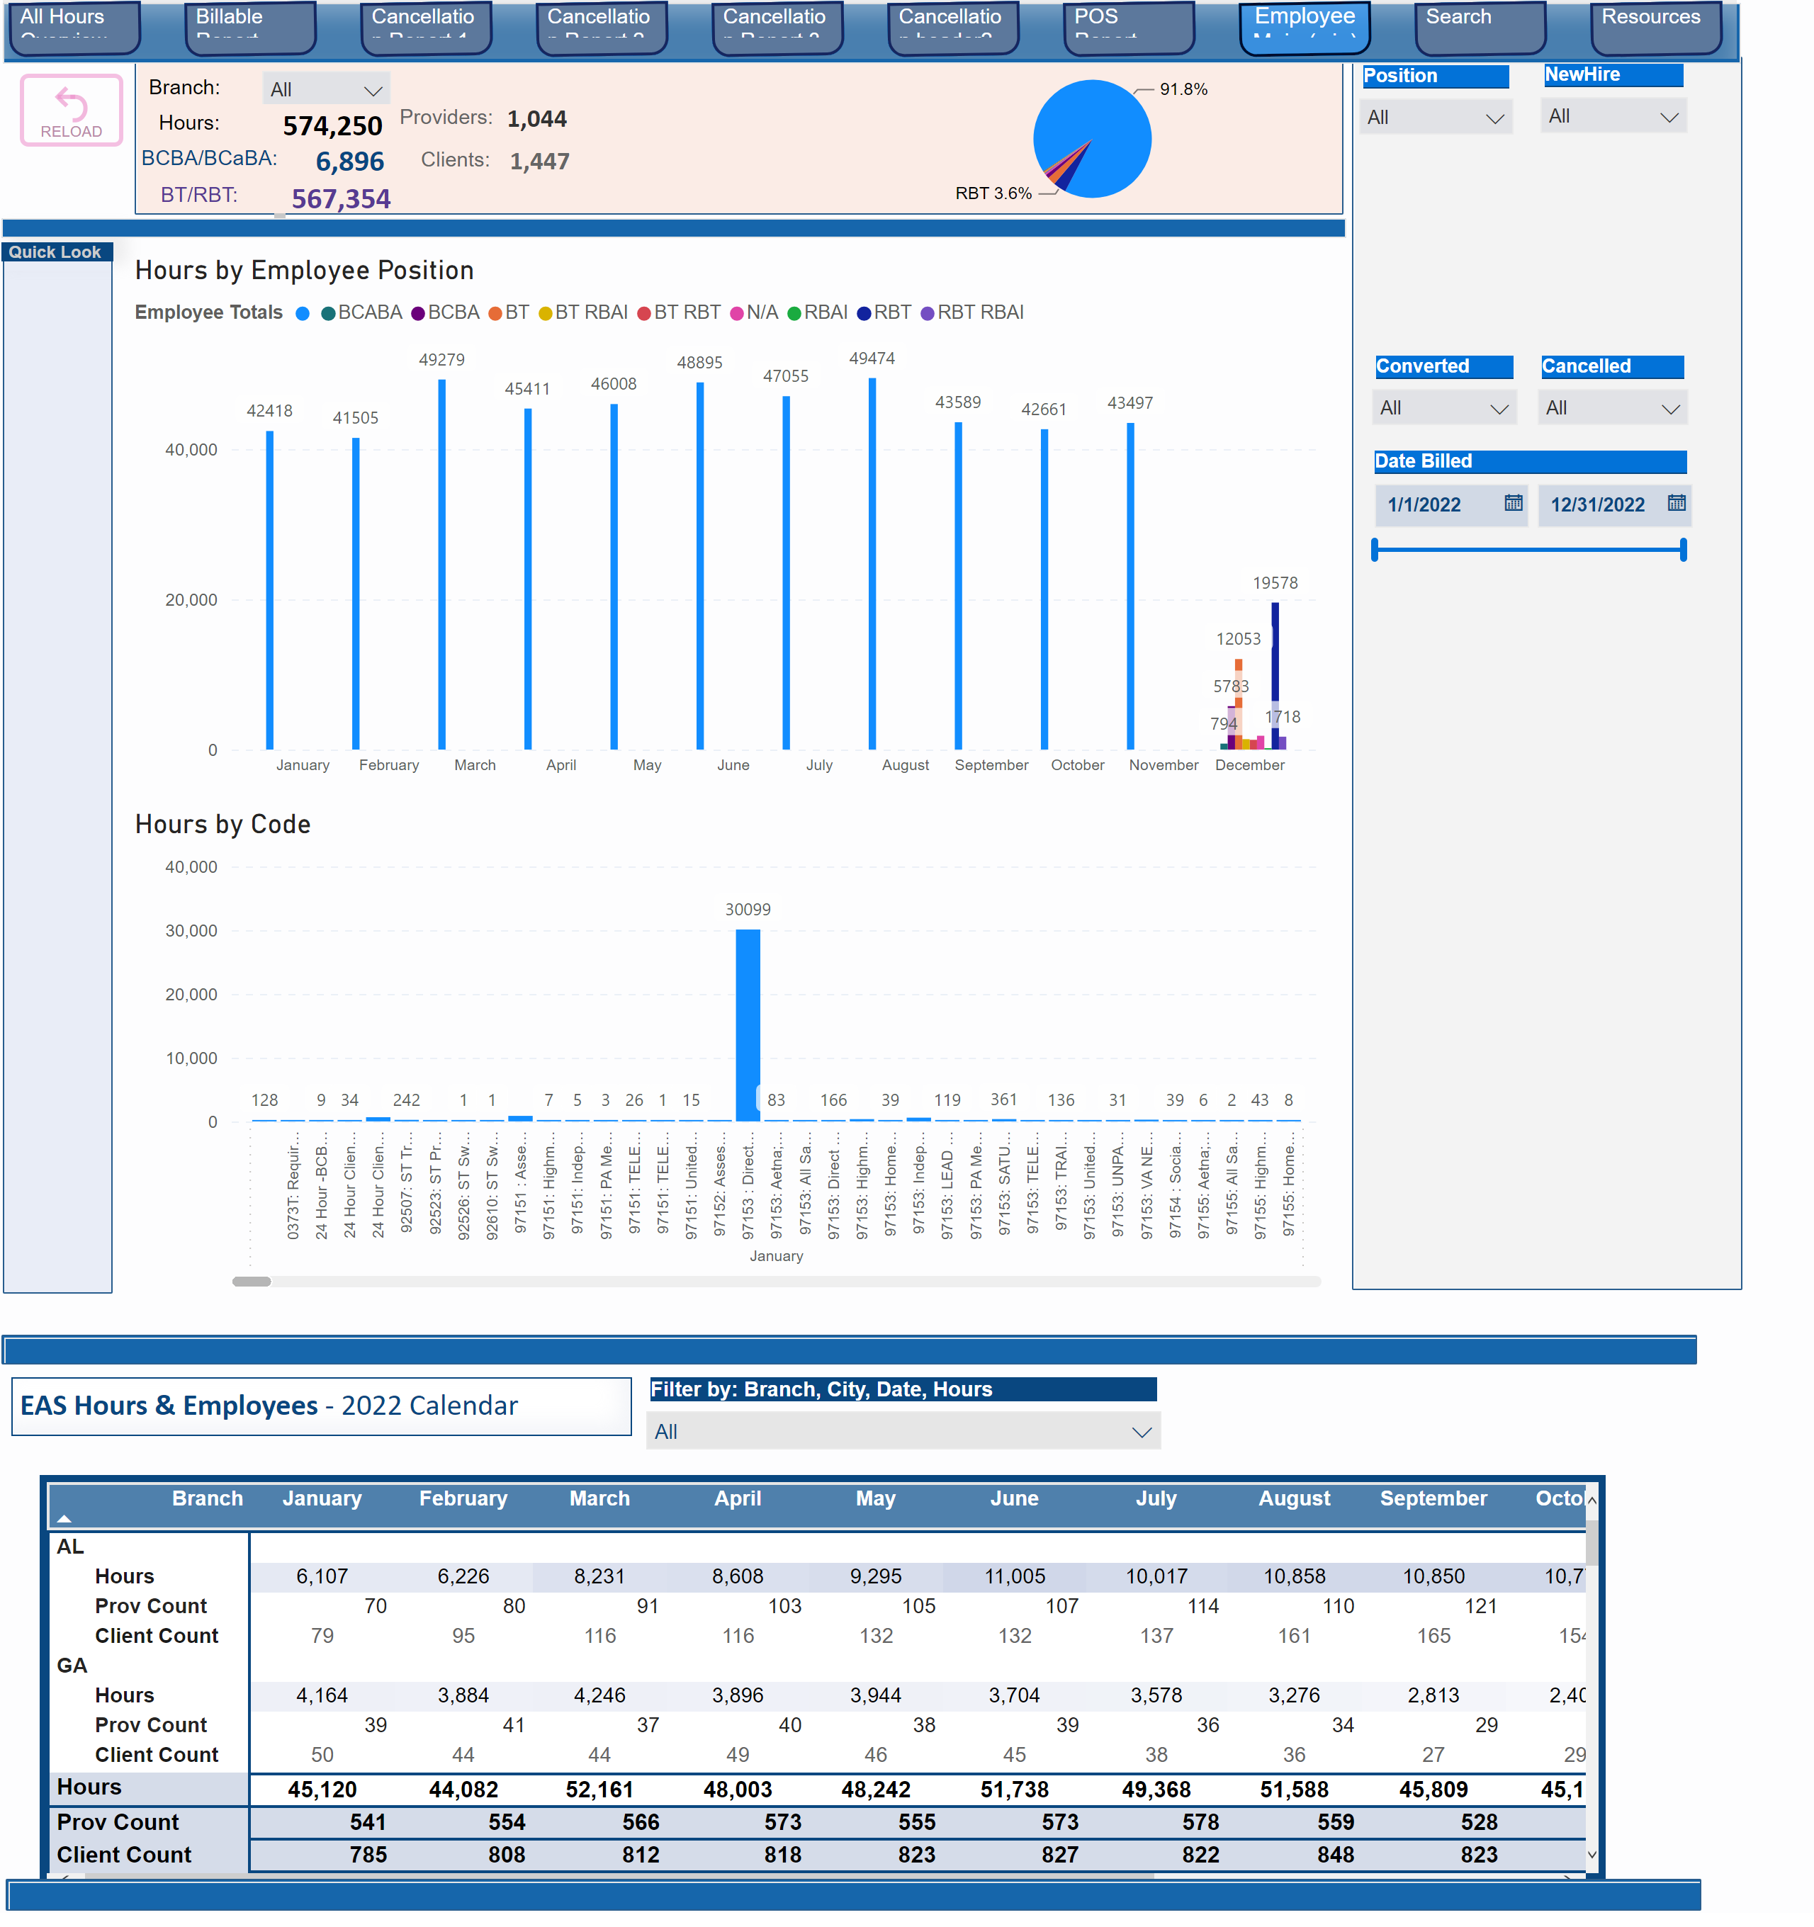
Employee Main (wip)
Notes:
slicer
No alt text provided
Hours by Employee Position
No alt text provided
Branch:
No alt text provided
slicer
No alt text provided
slicer
No alt text provided
Quick Look
No alt text provided
slicer
No alt text provided
slicer
No alt text provided
shape
No alt text provided
Clients:
No alt text provided
card
No alt text provided
BT/RBT:
No alt text provided
BCBA/BCaBA:
No alt text provided
Hours:
No alt text provided
card
No alt text provided
card
No alt text provided
card
No alt text provided
card
No alt text provided
Providers:
No alt text provided
textbox
No alt text provided
shape
No alt text provided
pieChart
No alt text provided
shape
No alt text provided
pivotTable
No alt text provided
shape
No alt text provided
shape
No alt text provided
textbox
No alt text provided
slicer
No alt text provided
slicer
No alt text provided
Hours by Code
No alt text provided
actionButton
No alt text provided
pageNavigator
No alt text provided
shape
No alt text provided

Slide 10
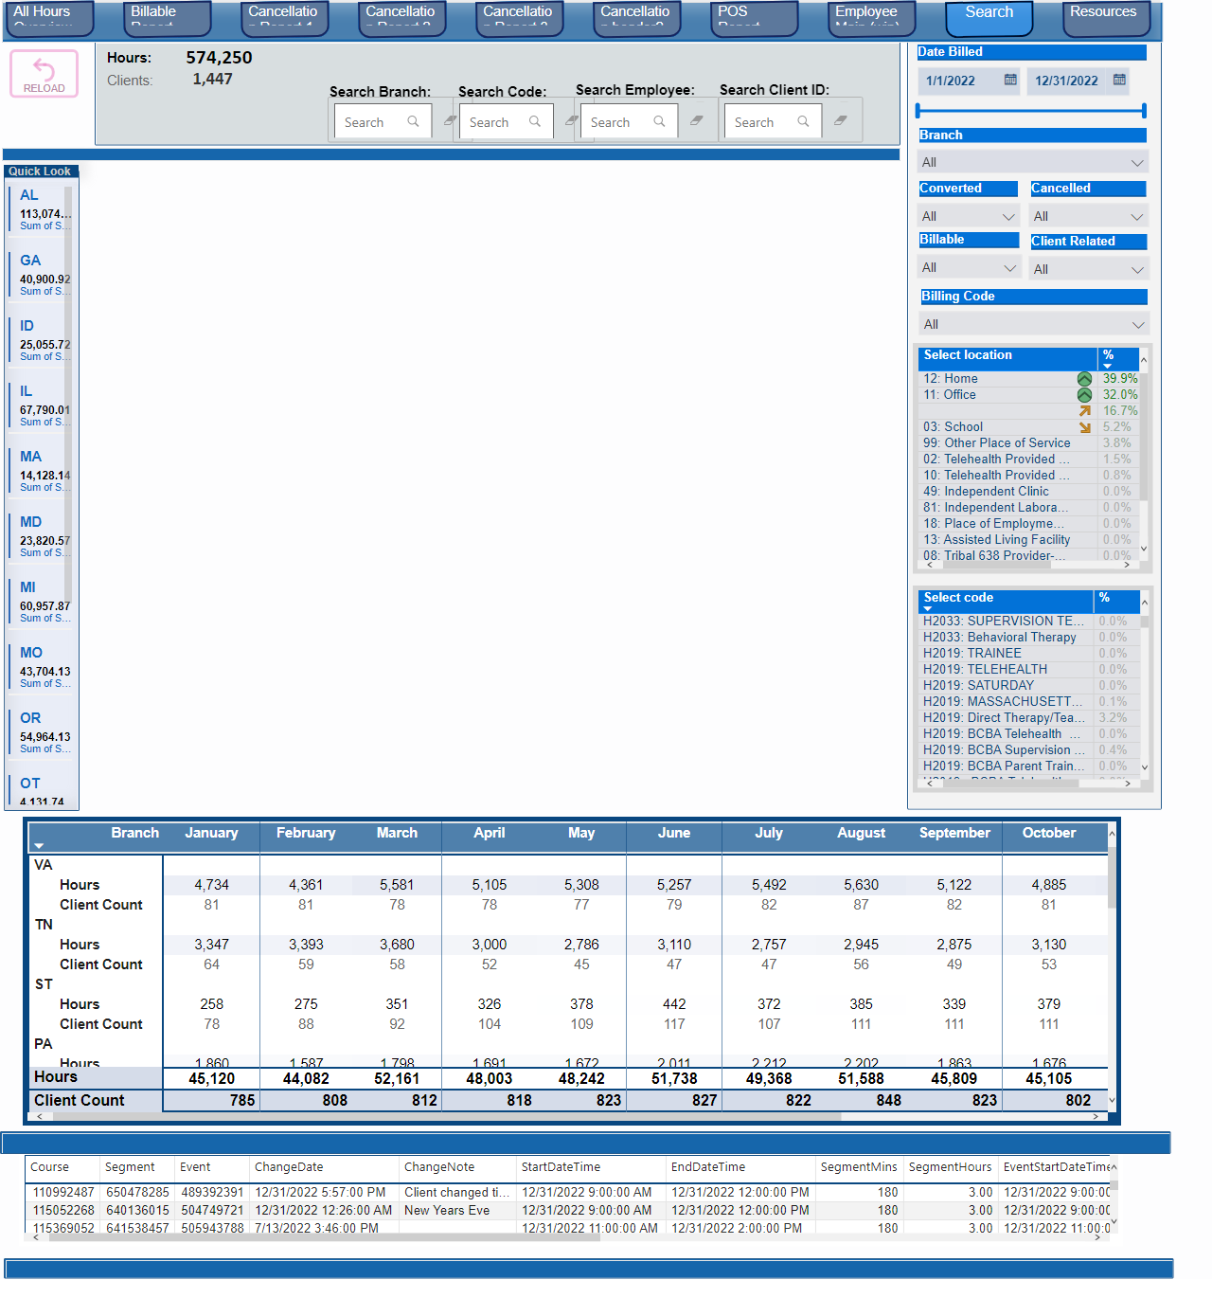
Search
Notes:
Search Code:
No alt text provided
textFilter25A4896A83E0487089E2B90C9AE57C8A
No alt text provided
textFilter25A4896A83E0487089E2B90C9AE57C8A
No alt text provided
Search Branch:
No alt text provided
Quick Look
No alt text provided
shape
No alt text provided
Hours:
No alt text provided
card
No alt text provided
card
No alt text provided
Clients:
No alt text provided
textbox
No alt text provided
shape
No alt text provided
Branch :
No alt text provided
pivotTable
No alt text provided
shape
No alt text provided
tableEx
No alt text provided
shape
No alt text provided
tableEx
No alt text provided
slicer
No alt text provided
slicer
No alt text provided
slicer
No alt text provided
slicer
No alt text provided
slicer
No alt text provided
slicer
No alt text provided
tableEx
No alt text provided
slicer
No alt text provided
Search Client ID:
No alt text provided
textFilter25A4896A83E0487089E2B90C9AE57C8A
No alt text provided
Search Employee:
No alt text provided
textFilter25A4896A83E0487089E2B90C9AE57C8A
No alt text provided
shape
No alt text provided
actionButton
No alt text provided
pageNavigator
No alt text provided
shape
No alt text provided

Slide 11
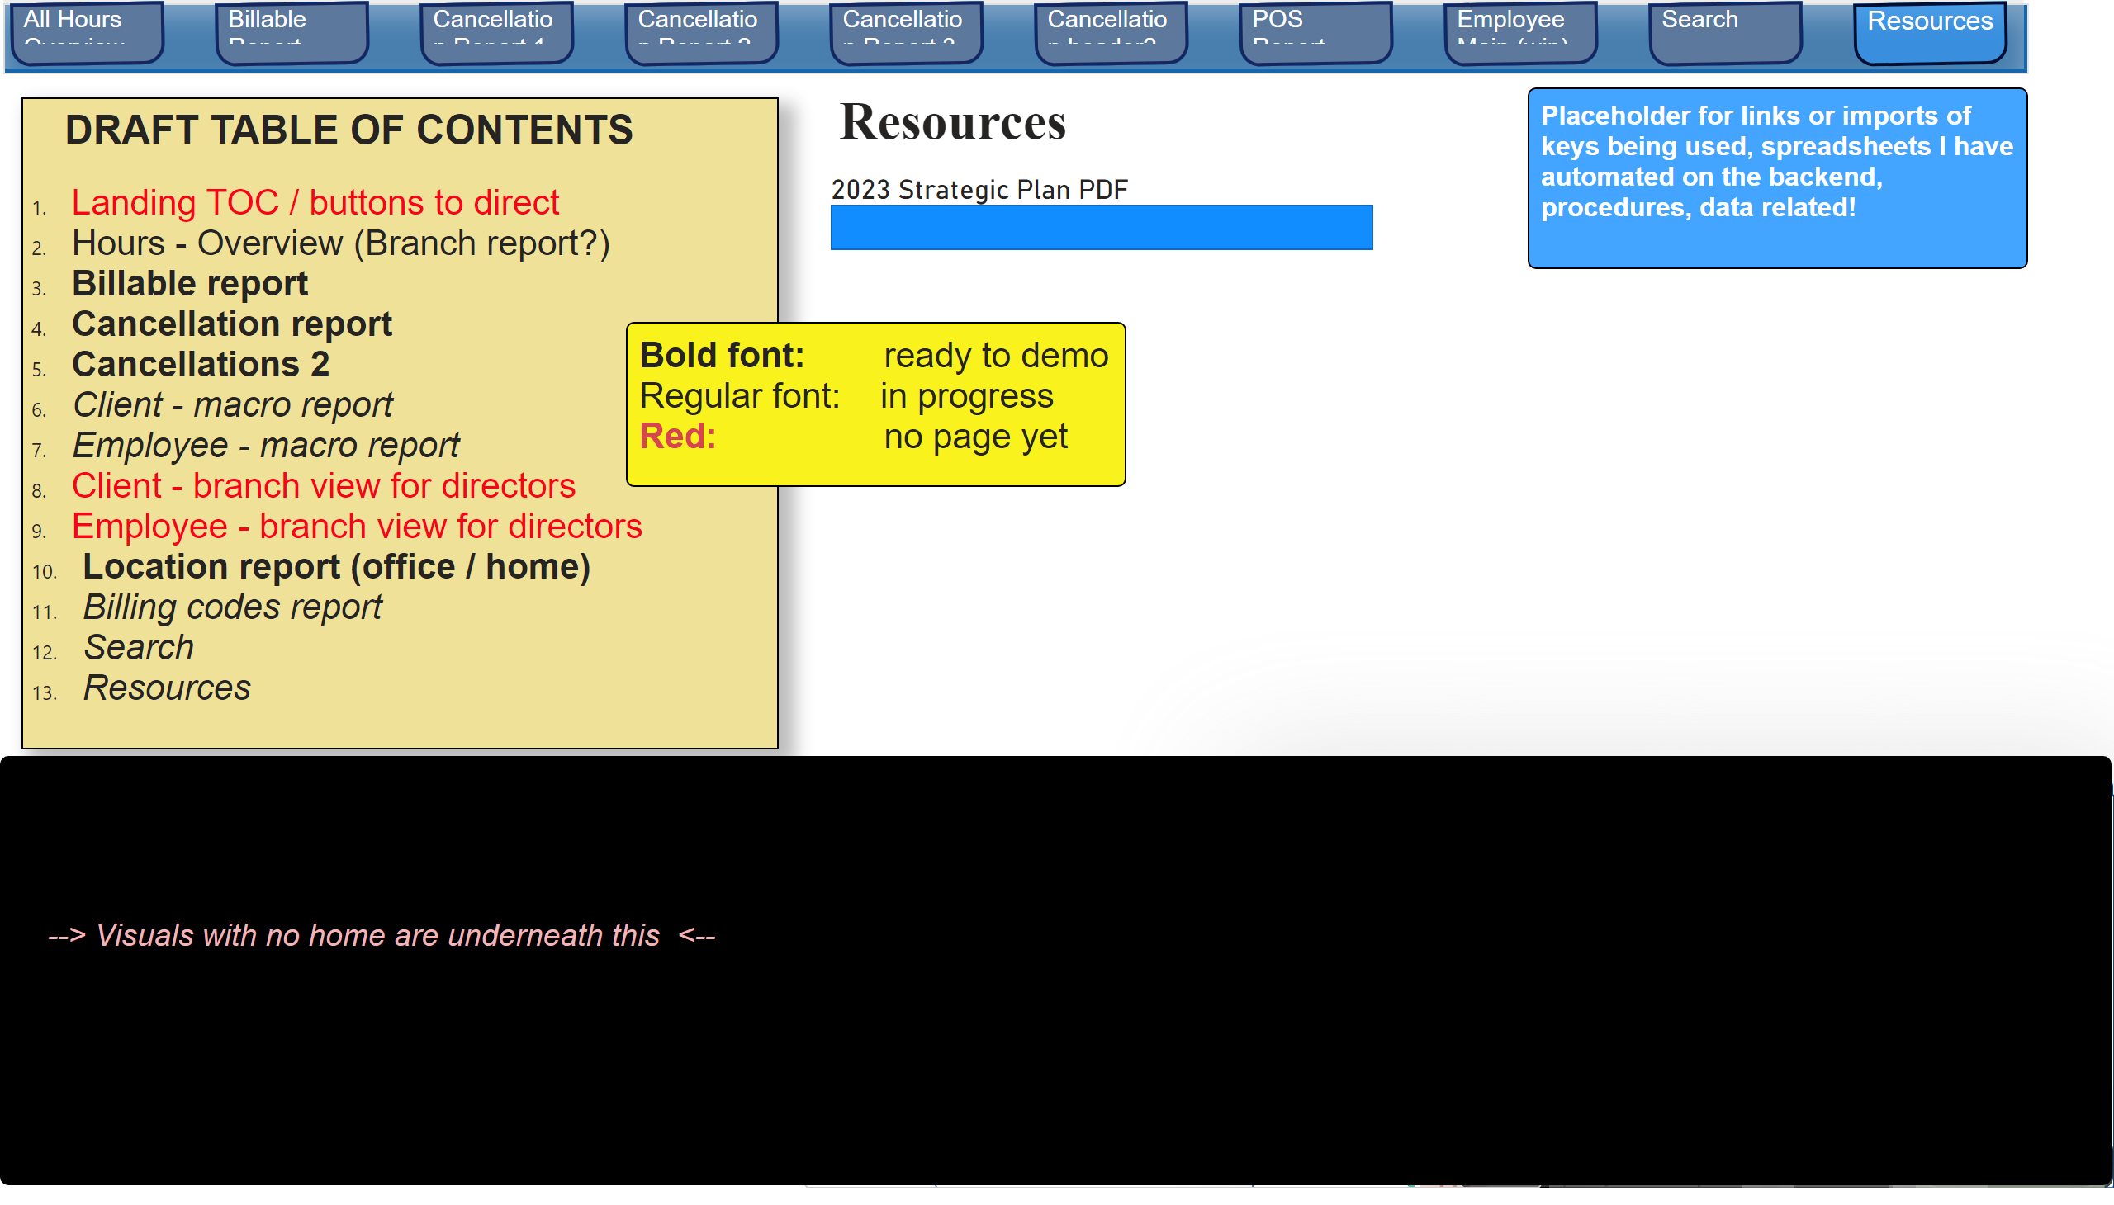
Resources
Notes:
textbox
No alt text provided
textbox
No alt text provided
2023 Strategic Plan PDF
No alt text provided
Branch :
No alt text provided
Current MTD monthly goal:
No alt text provided
Branch Hours - Converted Over Time
No alt text provided
CONVERTED v UNCONVERTED by BRANCH (Jan 1, 2022 - Present)
No alt text provided
In-home Clients & Client Active Dates
No alt text provided
multiRowCard
No alt text provided
multiRowCard
No alt text provided
card
No alt text provided
multiRowCard
No alt text provided
card
No alt text provided
card
No alt text provided
multiRowCard
No alt text provided
Cancellations In-Home v Clinic
No alt text provided
CONVERTED v UNCONVERTED by BRANCH (Jan 1, 2022 - Present)
No alt text provided
shape
No alt text provided
textbox
No alt text provided
textbox
No alt text provided
textbox
No alt text provided
pageNavigator
No alt text provided
shape
No alt text provided

